Slide 1
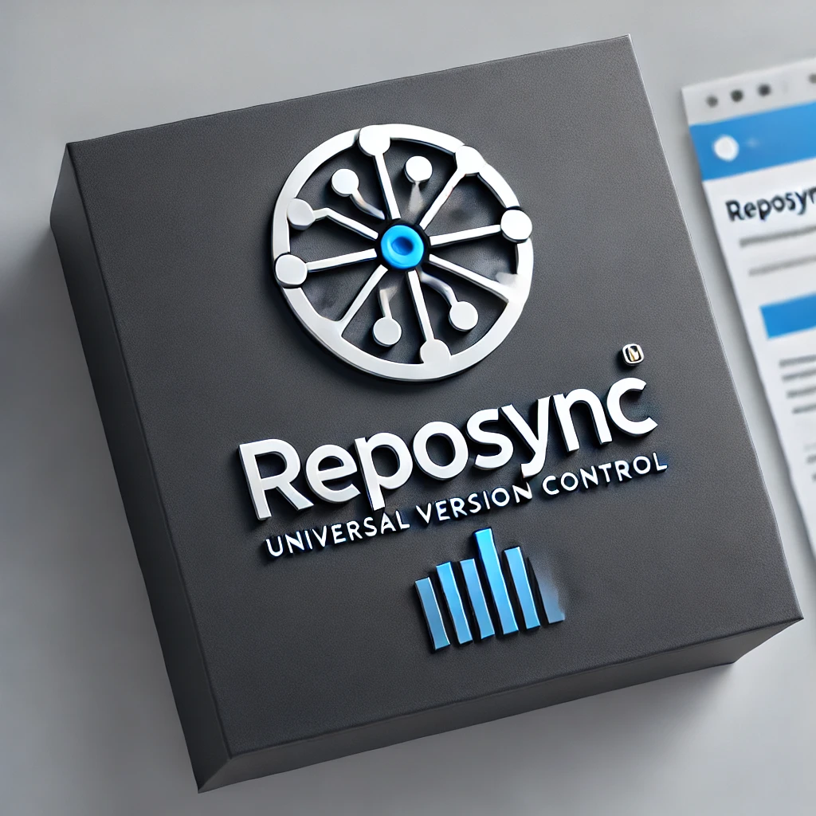

RepoSync Universal Version Control for Precision Industries
Abigail Dulski; MEng and B.S. in Computation and Cognition at MIT

Slide 2

Problem Statement
The Challenge: Traditional file collaboration tools (e.g., Google Drive, SharePoint) lack version control, auditability, and structured workflows for critical industries. Platforms with those features (GitLab, GitHub) are too technical for company-wide collaboration.
Industry Impact: In precision industries (pharmaceuticals, biotechnology, finance, prototyping), mistakes in document versioning can lead to costly errors, compliance issues, and inefficiencies.

Slide 3
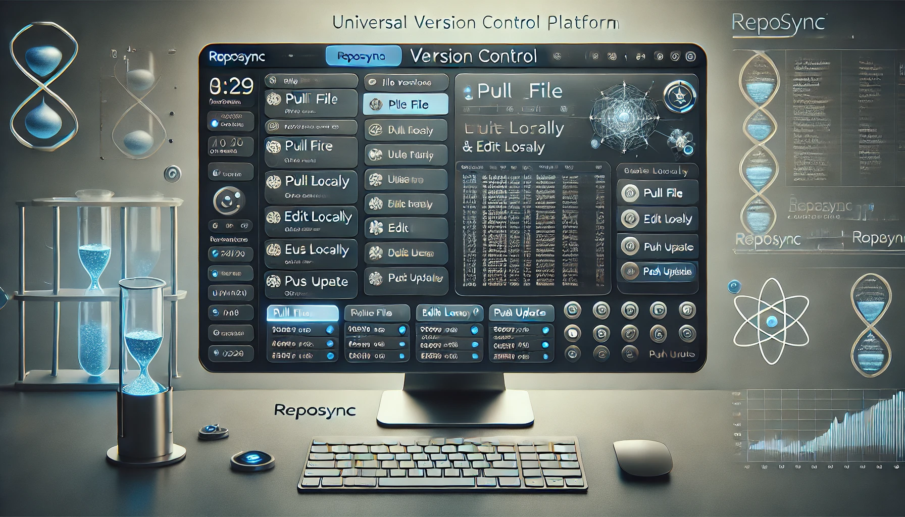
The Solution: RepoSync
A universal version control platform that allows employees to collaborate with any file type as seamlessly as software developers using Git.
Employees will have personalized accounts and can download local copies, push updates with versioning, and track changes with full transparency.
AI-powered recommendations will be available to improve workflow efficiency and document accuracy.

Slide 4
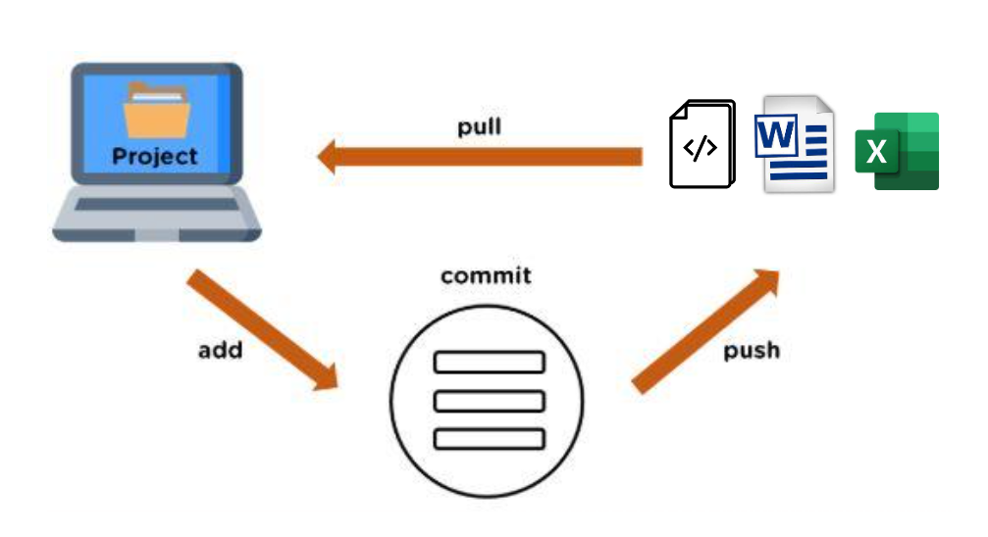

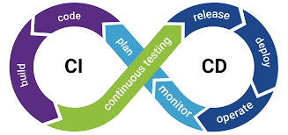

How It Works
Version Control: Users pull and push files with versioning, maintaining a clear audit trail
CI/CD for Documents: Files move through a structured pipeline ensuring approval and compliance
AI-Powered Insights: Personalized document suggestions based on past activity and organizational knowledge
Security & Compliance: Industry-standard encryption, role-based access, and audit logs

Slide 5

Why Now? (Market Timing)
Increased Digitalization: Pharmaceutical and biotechnology are embracing cloud & AI-driven workflows.
Rising Compliance Needs: Regulatory demands for traceable & auditable documentation
AI & Automation Growth: Companies seek intelligent collaboration tools to enhance efficiency
“Digitization has the potential to fundamentally transform pharma operations, opening the door to step-change improvements in performance. (Strategy &; Digitization in Pharma; 1)

Slide 6
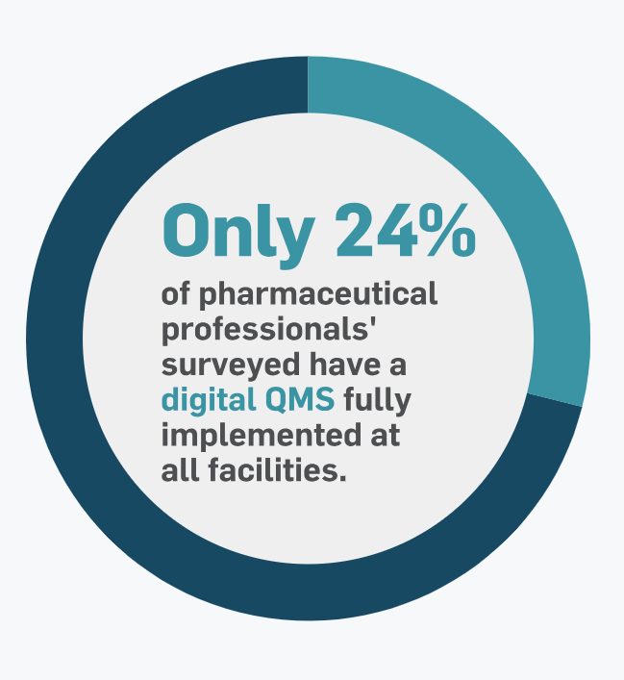
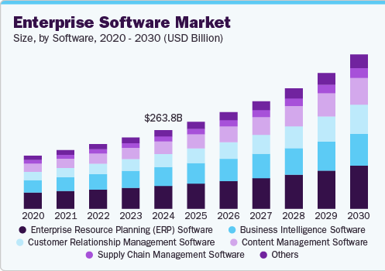
Market Opportunity
Pharmaceutical & Biotech Market Size: $1.5T+ industry with increasing digital transformation needs.
Enterprise Collaboration & Version Control: Market projected to grow $25B+ by 2028
Target Customers: biotech & pharmaceutical R&D teams, regulatory departments, manufacturing, and finance.
(MasterControl; 2024 Pharmaceutical Trends; 2)
(Grandview Research; Enterprise Software Market Size; 3)

Slide 7
Competitive Landscape
Competitor | Strengths | Weaknesses
Google Drive / SharePoint | Ubiquity, ease of use | Poor version control, lack of structured workflows
GitHub / GitLab | Best-in-class for code | Not optimized for non-code collaboration or for collaboration between non-programmers
Industry LIMS / ELN Systems | Industry compliance | Expensive, limited to very specific workflows
RepoSync | Universal version control, AI-powered recommendations, compliance-first | First mover advantage in this space

Slide 8
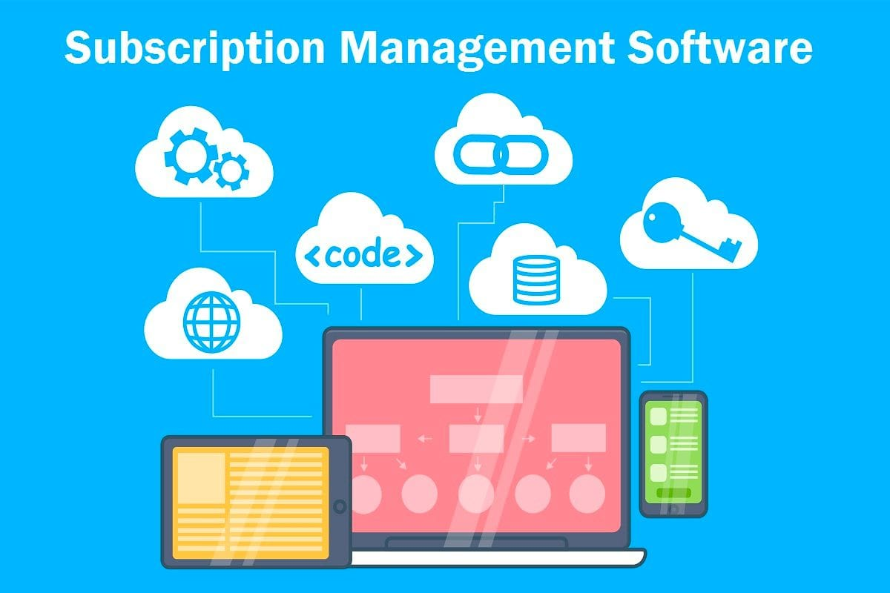
Business Model (Very Early Proposal)
SaaS Subscription: Per-user, per-enterprise pricing
Custom Enterprise Deployments: Tailored platforms for larger clients
Add-On Services: AI-driven workflow enhancements & compliance audits

Slide 9



Go-To-Market Strategy
Early Adopters: Small-to-mid biotech and pharmaceutical companies
Partnerships: Collaboration with regulatory bodies and clous providers
Sales Channels: Direct sales, enterprise outreach, and conferences

Slide 10
Roadmap & Milestones
Phase 1: (0-6 months): MVP with core version control & CI/CD for documents
Phase 2 (6-12 months): AI-driven recommendations & early enterprise pilots
Phase 3 (12-24 months): Expansion into larger pharmaceutical companies and compliance integration

Slide 11

Team
Founder/CEO: Abigail S. Dulski
MIT CS and Neuroscience, expertise in AI and data processing
Industry experiences at Amgen and IBM
Leadership experience within D1 Collegiate athletics, Society of women in engineering, volunteer organization camp kesem, and sorority organization kappa alpha theta

Slide 12
Wrap-Up
RepoSync is revolutionizing file collaboration for precision industries. Join us in transforming how biotech, pharmaceuticals, finance, and manufacturing manage critical files!

Slide 13
Sources
Ehrhardt, Marcus. “Gaining an Edge in Operations Digitization in Pharma.” Digitization in Pharma, www.strategyand.pwc.com/gx/en/insights/2016/digitization-in-pharma/digitization-in-pharma.pdf. Accessed 12 Feb. 2025.
“2024 Pharma Industry Trends - Digital Quality Manufacturing.” MasterControl, www.mastercontrol.com/resource-center/quality-manufacturing/pharma-industry-trends-2024/?utm_campaign=701PQ0000089UFJYA2&utm_medium=Online-Ads&utm_source=GO&gad_source=1&gclid=CjwKCAiAh6y9BhBREiwApBLHC_B_c_VkF2d7ZoOeldtqY-mone0GXYxHEHWPeUIS6Z8NMfbJ9BiehBoCkT4QAvD_BwE. Accessed 12 Feb. 2025.
“Enterprise Software Market Size, Share, Growth Report 2030.” Enterprise Software Market Size, Share, Growth Report 2030, www.grandviewresearch.com/industry-analysis/enterprise-software-market. Accessed 12 Feb. 2025.

